Slide 1
QuickStudy
HACKATHON WEEK 1
Learn faster with flashcards and quizzes
A study site we built for students. Make your own cards, or upload a PDF and get questions back.
Cameron Ruiter
Evaldas Pocius
Notes:
Hi - we built QuickStudy, a study site for students. Flashcards, quizzes, and a tool that turns a PDF into questions.

Slide 2
Who it's for
Students revising for exams
Anyone learning something new
Teachers and tutors
Build a question set once and hand it to a whole class.
Turn a term's worth of notes into cards they can drill the night before.
Languages, driving theory, a certification - any subject you can write questions for.
Notes:
Three kinds of students. The common thread: they already have material - notes, slides, a textbook chapter - and need a way to test themselves on it.

Slide 3
How it works
1
2
3
Create a subject
Add your questions
Test yourself
History, biology, whatever you're studying.
Write cards yourself, or drop in a PDF and let the site write them.
Flip through cards or take the quiz, and watch your score move.
Notes:
Three steps. Pick a subject, fill it with cards - by hand or from a PDF - then test yourself. Everything is organised by subject.

Slide 4
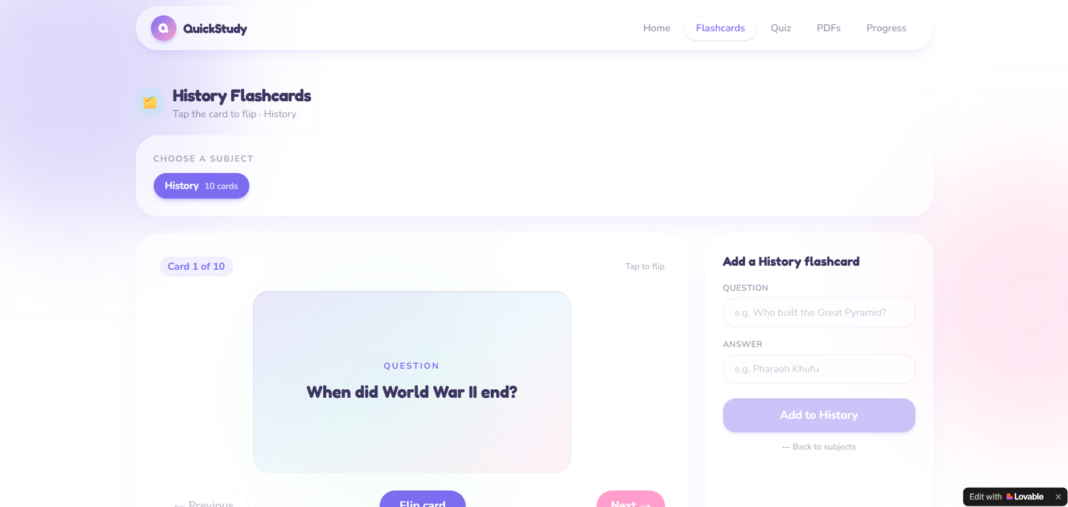
Flashcards you write yourself
Type a question and an answer, and it's in the deck. Tap the card to flip it.
Cards live inside a subject, so a deck stays about one thing.
Notes:
This is the flashcards page. Tap a card to flip it. The panel on the right is where you add your own question and answer - it goes straight into the subject.

Slide 5
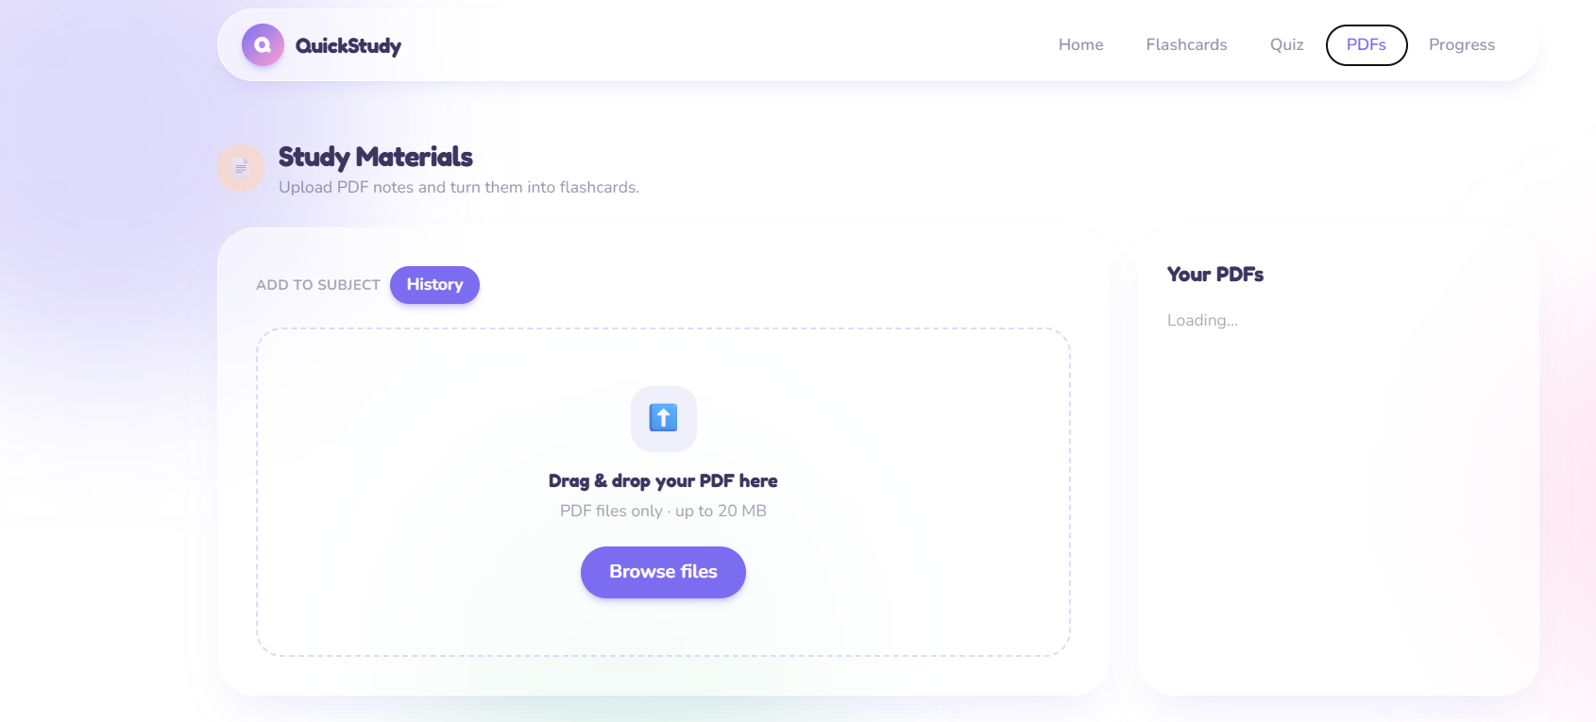
Upload a PDF, get questions
Drop in lecture notes or a chapter and the site reads it and writes the questions for you.
They land in the subject you chose, ready to study.
Notes:
The part people react to. Drag in a PDF of lecture notes and the site reads it and outputs questions for that subject. No typing.

Slide 6
Quizzes and progress
Quiz mode
Progress
Your cards come back as a scored quiz, so you find out what you actually remember instead of what looks familiar.
Mastery is tracked per subject, so the next session starts where the last one left off.
Everything is organised by subject: cards, PDFs, quiz scores and progress all sit together.
Notes:
Once you have cards, quiz mode asks them back at you and scores you. The progress page shows mastery per subject, so you know what to study next.

Slide 7
Why students use it
Setup takes minutes
It's your material
A PDF you already have becomes a full question set without typing it out.
Questions come from your own notes, not a generic deck written for someone else's course.
Testing beats re-reading
You can see where you stand
Quizzing yourself is what makes things stick, and the site is built around doing that.
Progress per subject tells you what to revise next instead of guessing.
Notes:
Why use this over paper cards or another app. Faster to set up, it uses your own material, and it tells you where you stand.

Slide 8
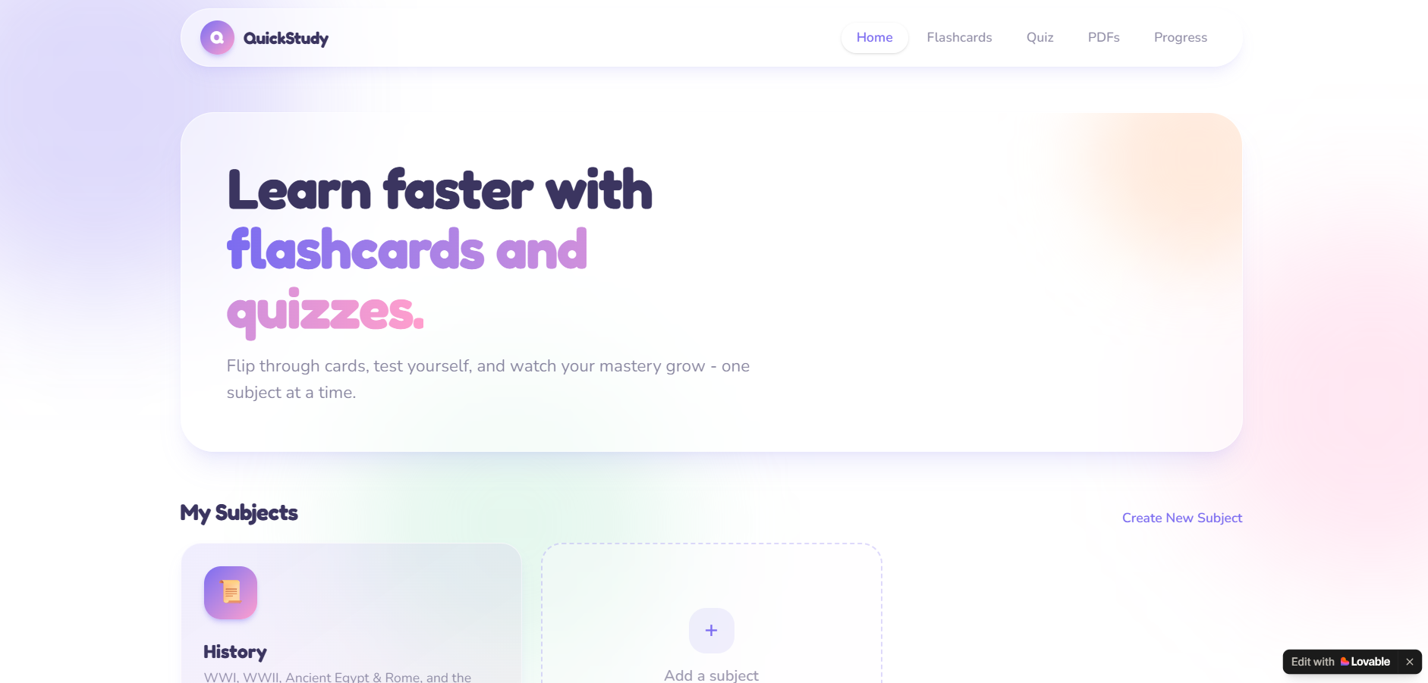
Try it with your own notes
Make a subject, add a few cards or upload a PDF, then quiz yourself.
It's live now and free to use.
Notes:
It's live and usable today. Pick a subject, add a few cards or a PDF, and take a quiz. Happy to demo it now.

